Slide 1

Frontend Presentation

Slide 2
INTRODUCTION
Angular, a popular front-end JavaScript framework, offers a powerful and flexible platform for building dynamic web applications.
Leveraging Angular's capabilities, we have created data-rich tables that not only present information in a visually appealing manner but also offer interactivity, sorting, filtering, and seamless data manipulation.

Slide 3
Reusable Component
UI Components
Data Display Components
Layout Components
Form Components
Directive Components

Slide 4
Technologies Used
Angular Framework -15
Visual Studio -1.80.2
Node JS-18.12.1

Slide 5
Feature Set
Adding comments to cells
Aggregation
Aligned Grids
Cell & Row Selection (Single, Multi, Keyboard, Checkbox)
Cell Editing, Inline Editing, Inline Add/Edit/Delete
Cell Rendering, Cell Style
Clipboard
Client/Server-side Pagination & Sorting
Column Menu, Context Menu
Column Filter, Column Groups, Column Moving, Column Pinning, Column Resizing
Column Reordering & Resizing

Slide 6
Feature Set
Conditional formatting
CSV, Excel, PDF Export
Custom Filter, Date Filter
Data Summaries
Data validation
Dynamic Search
Event Handling on row
Expressive Header and Cell Templates
Fixed AND Fluid height
Freezing rows/columns
Grouping Rows, Master/Detail
Horizontal & Vertical Scrolling

Slide 7
Feature Set
Intelligent Column Width Algorithms (Force-fill & Flex-grow)
Integrated Pager
Keyboard Navigation
Left and Right Column Pinning
Overlays
Pagination
Pivoting, Range Selection
Real-Time Updating Data
Responsive Design
Row Detail View, Row Selection, Row Sorting, Row Dragging
Status Bar, Tool Panel
Tree Data

Slide 8
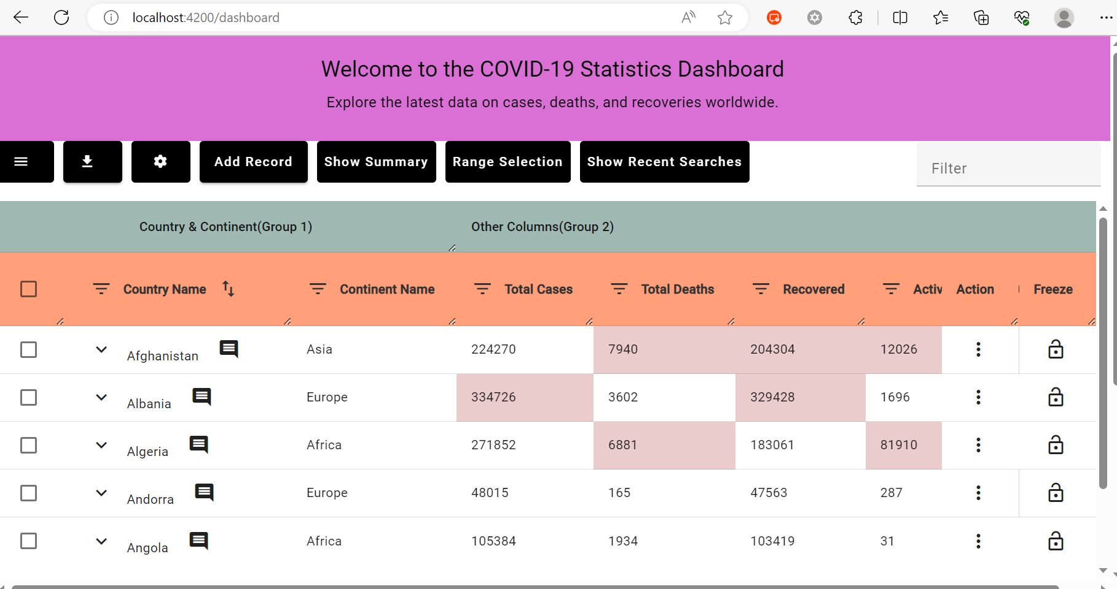
SNAPSHOTS: Dataset 1

Slide 9
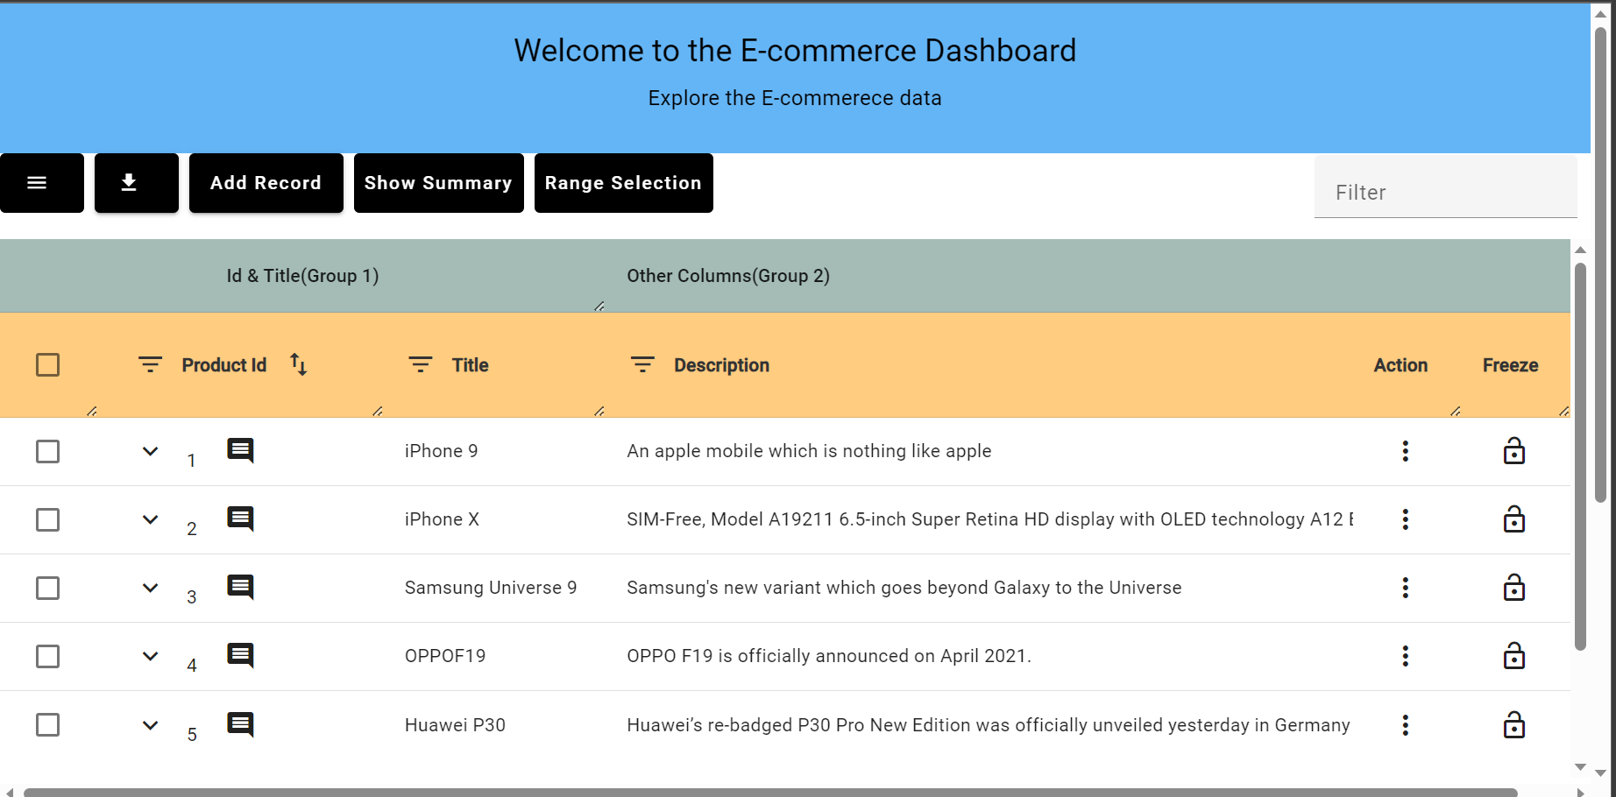
Dataset 2

Slide 10
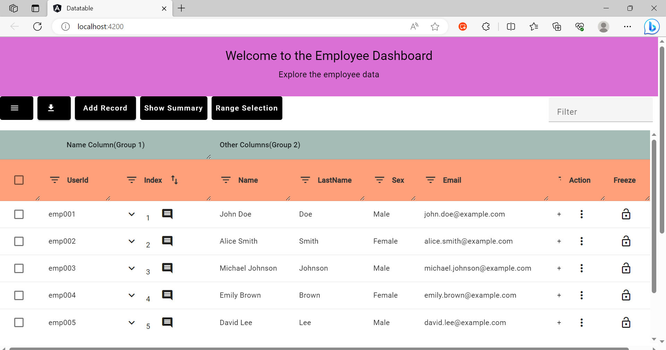
Dataset 3

Slide 11
CONCLUSION
During the development of this web application, we had the opportunity to explore and learn numerous new concepts in Angular, significantly enhancing our knowledge and expertise in the framework.

Slide 12

THANK YOU

